Slide 1
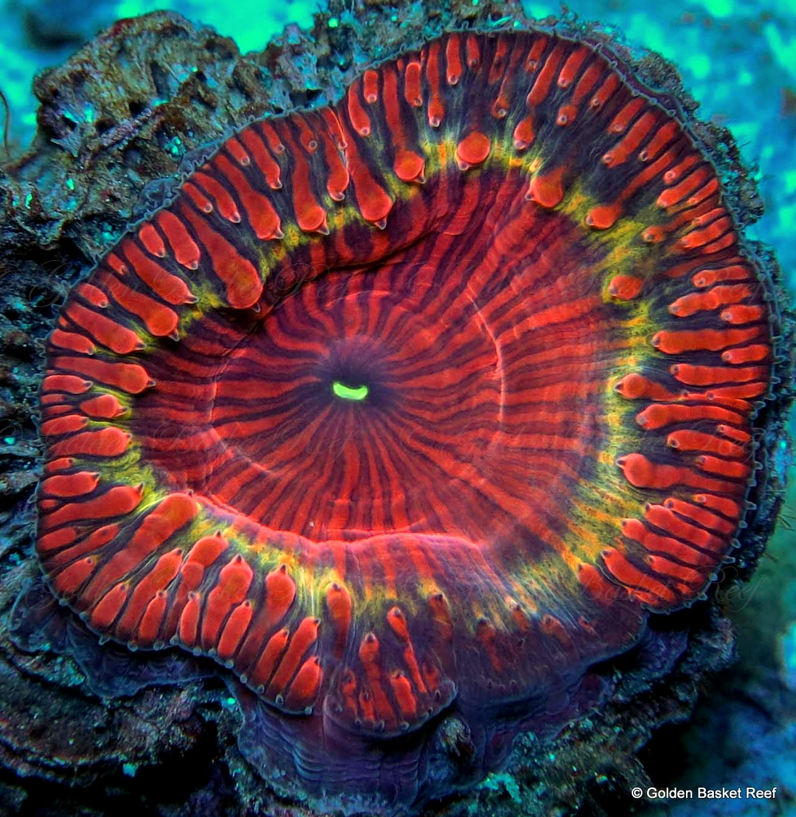
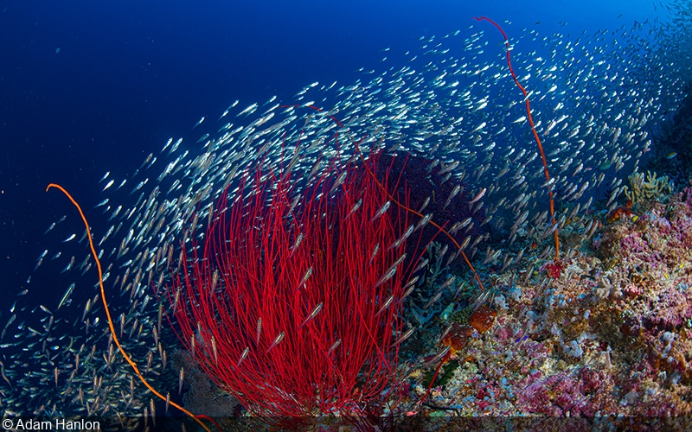
ReefRescueFund
Richard Patriquin
Yohei Waki
Shahadath Farouk
Simon Sakkal
Matthew Buchanan

Slide 2

Introduction
ReefRescueFund (RRF) is a revolutionary platform, harnessing the power of blockchain and NFT’s.
RRF uses decentralisation and the power of smart contracts to auction sections of the Great Barrier Reef.
Funds are deposited into the RRF’s trust account which has been fully audited by all relevant regulators.

Slide 3
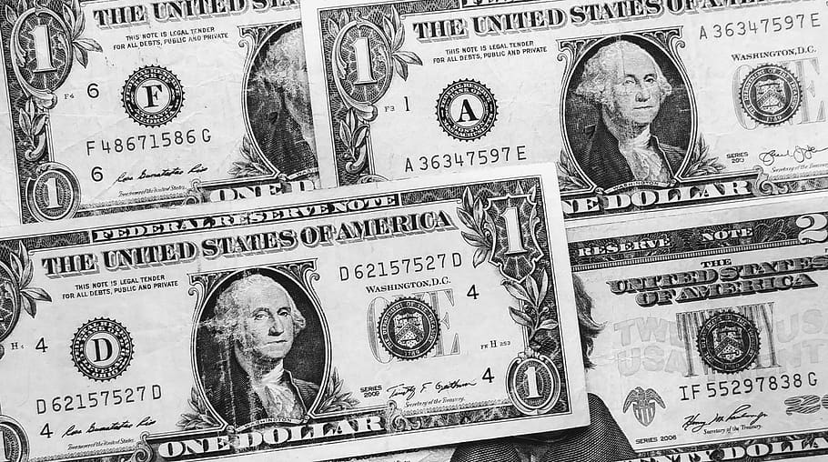


Fund Management
The capital we raise is used in two ways:
Lobbying government (local, state and national) through our industry partners.
Raising awareness of the Great Barrier Reef through marketing activities.

Slide 4
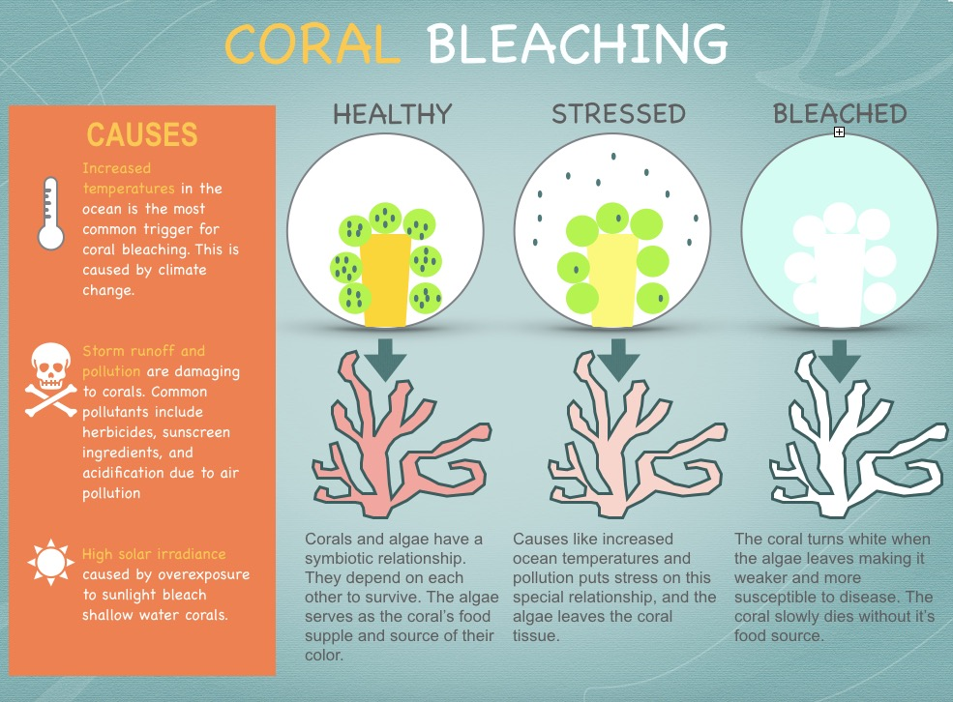
Coral Bleeching
Coral bleeching occurs when corals lose their vibrant colors and turn white and eventually die.
The leading cause of coral bleeching is climate change, resulting in warmer ocean temperatures. With an increase of as little as 2 degrees fahrenheit coral bleaching can occur.
The Great Barrier Reef is the world’s largest reef systems and is composed of roughly 2,900 individual reefs and 940 islands stretching across 2,300 kms covering approx 344,499 square kilometres.

Slide 5

Why our work matters
⍰
Coral bleaching matters because once the corals die, reefs rarely come back. If only a fraction of the corals remain, they struggle to reproduce resulting in the entire reef ecosystem to deteriorate and eventually vanish.
Coral bleaching impacts people's livelihoods, food security and the economy. According to a 2017 Deloitte report the Great Barrier Reef has a economic, social and icon asset value of $56 Billion. It supports 64,000 jobs and contributes $6.4 billion to the Australian economy.
The Great Barrier Reef is so much more than just a reef and its sustainability is of importance for all Australians.

Slide 6
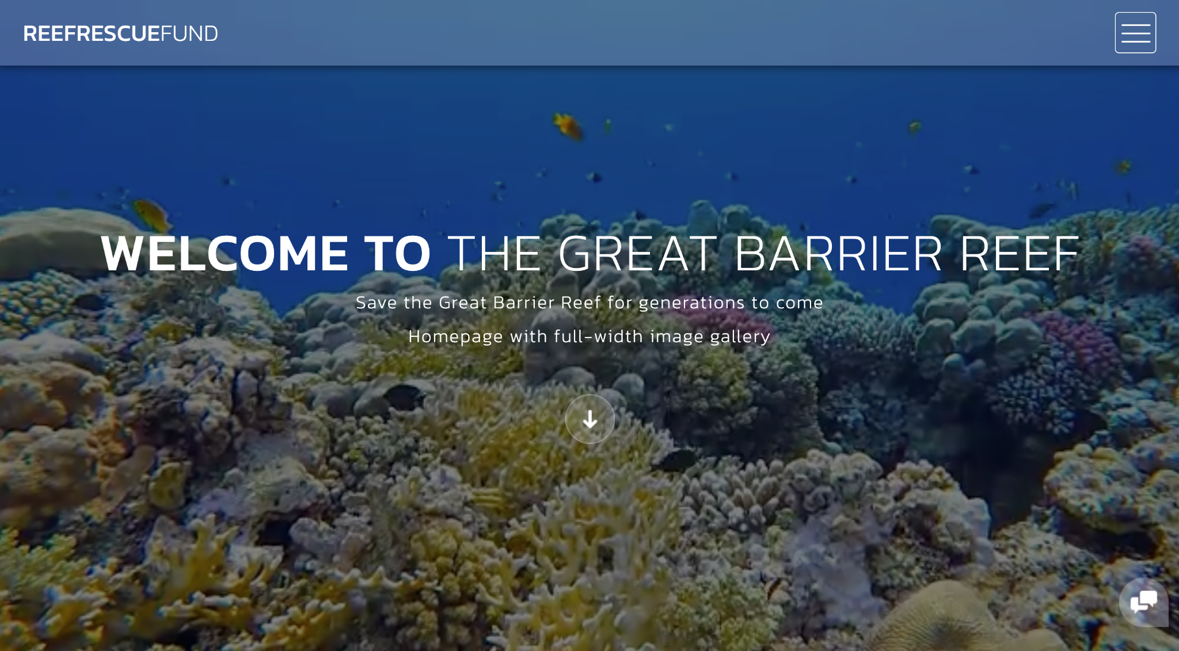
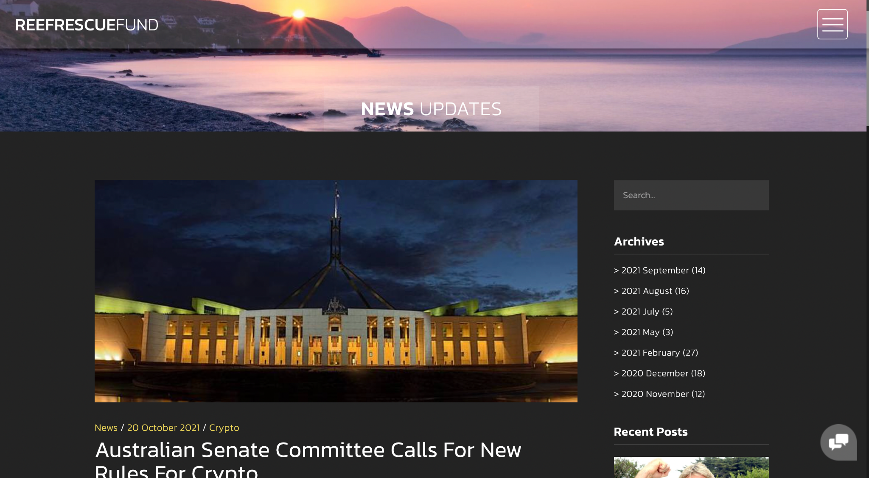
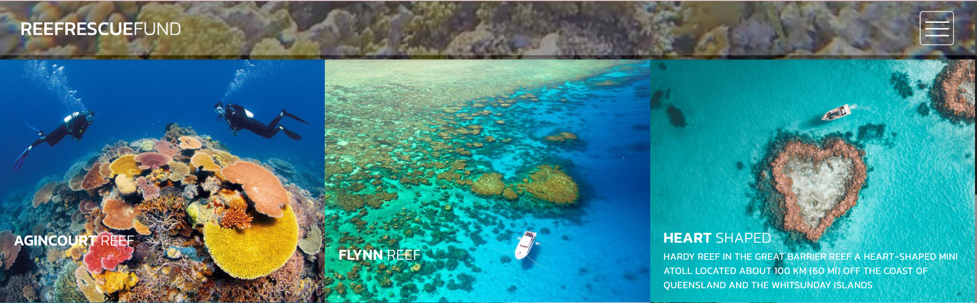
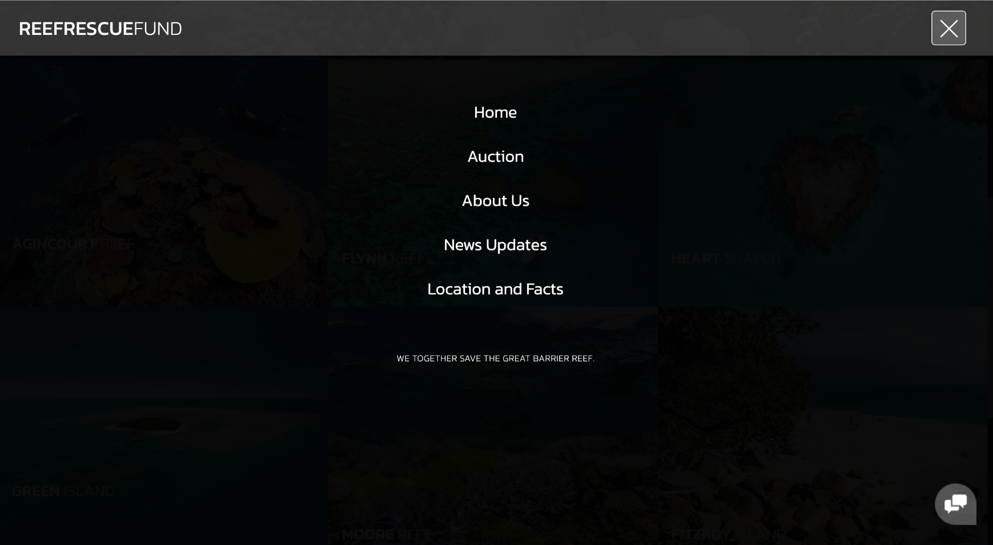
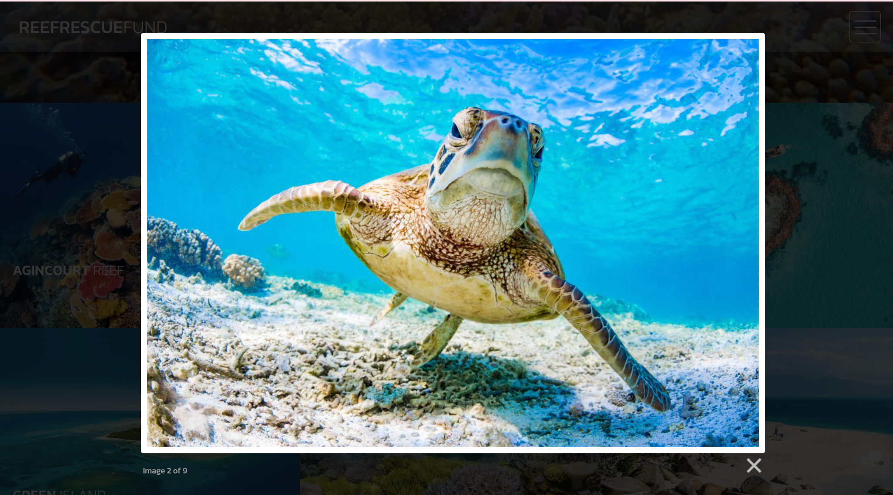
Interactive Website
Html CSS and JavaScript
Main page
Auction site
About us & News
Location map
& Facts

Slide 7
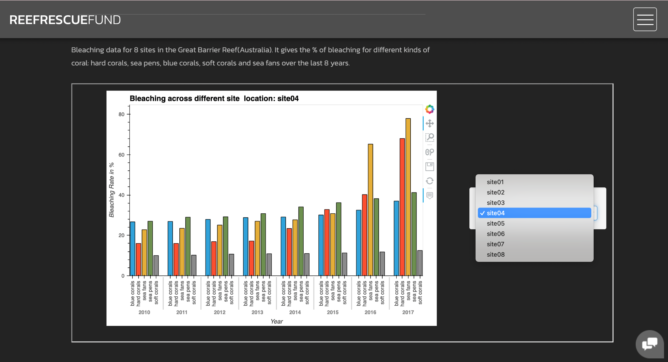
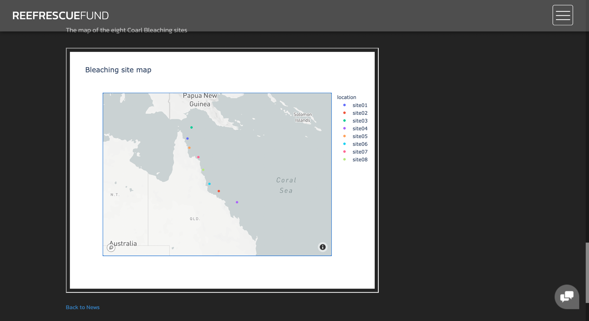
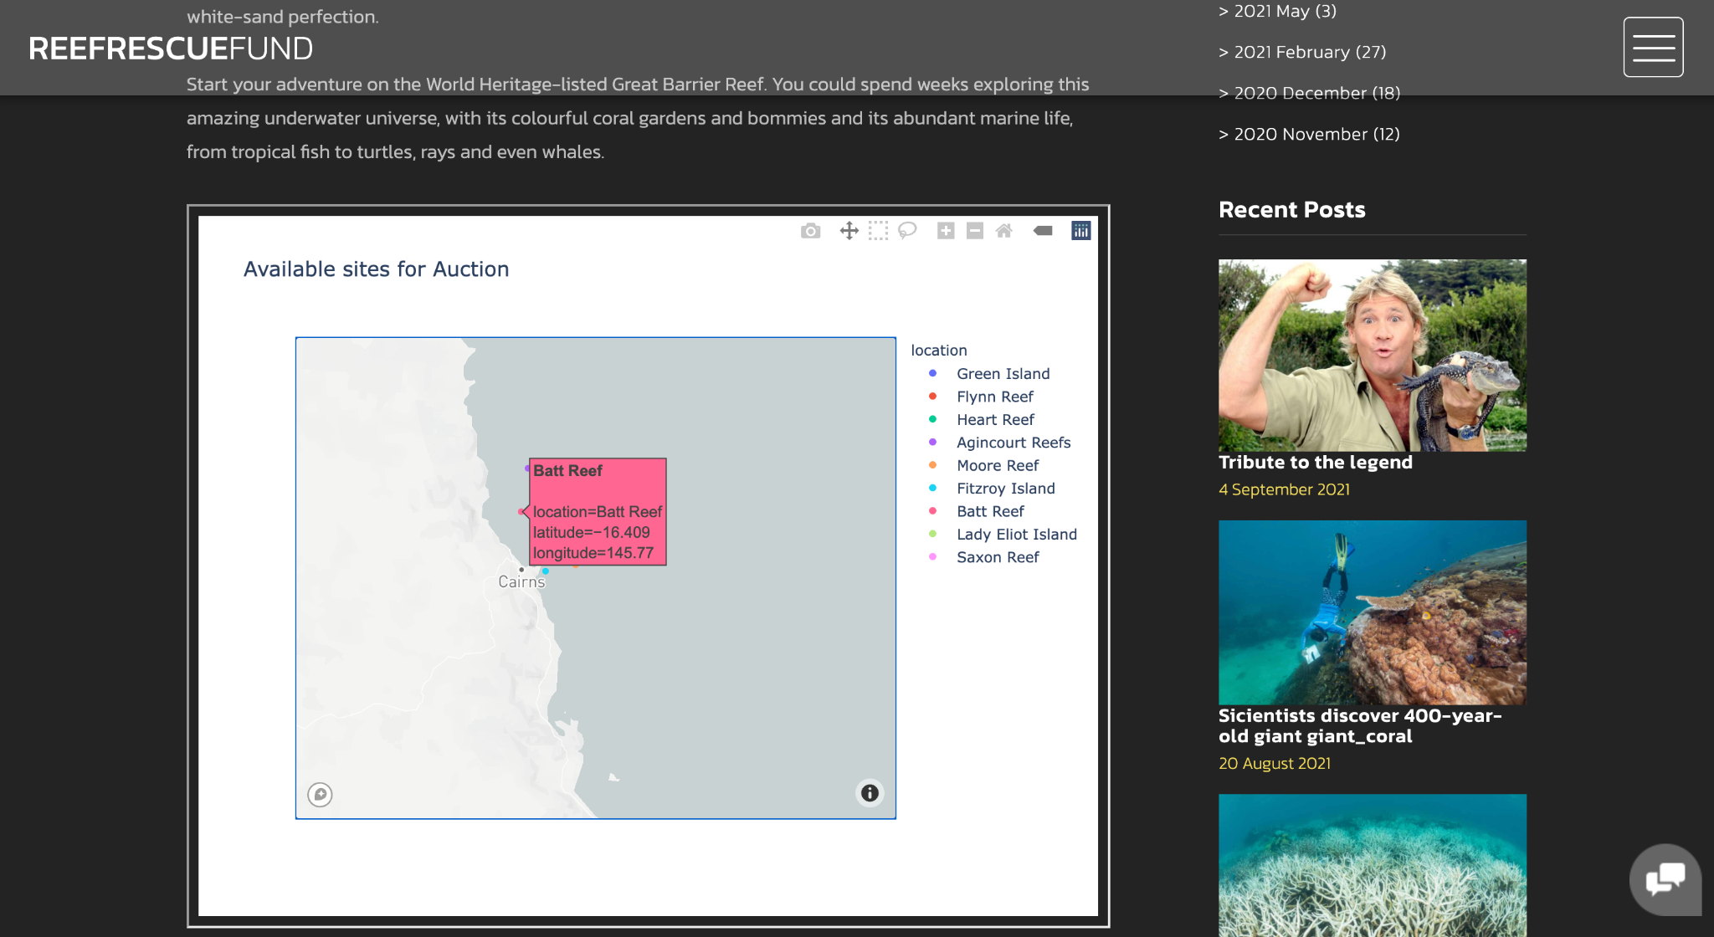
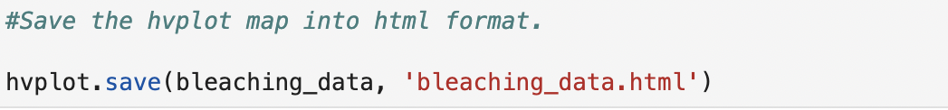
Interactive Website
Python
Plotly Visualization embedded onto the Website
Scatter Mapbox and HvPlot to show graphs and maps
Save into html file to interact with the website

Slide 8

DEMO - Introduction

Slide 9

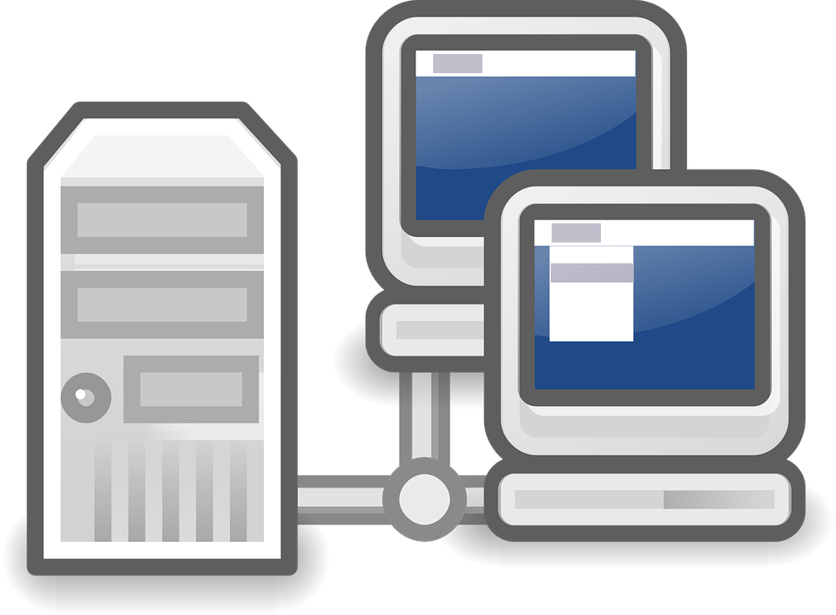

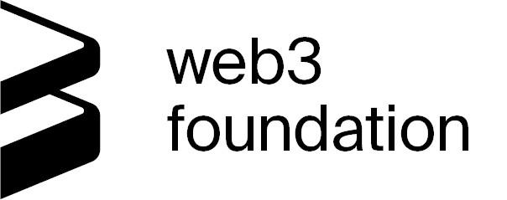
Development Environment
Ganache
Node.js
Web3.js
Lite-server
Truffle

Slide 10
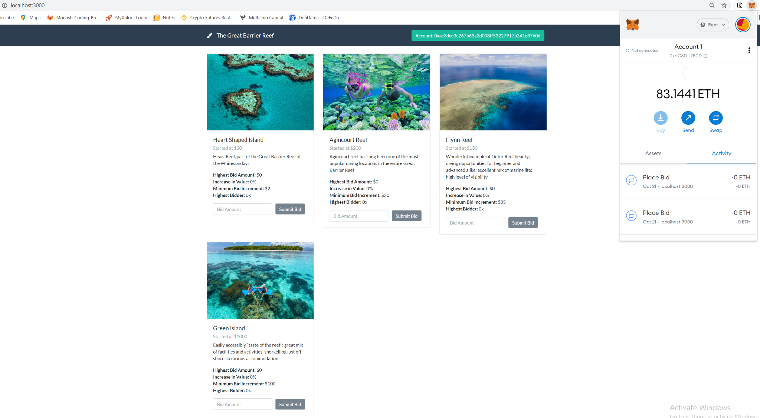
Auction
Decentralized Application uses Solidity, JavaScript, and HTML/CSS for deployment on the Ethereum Blockchain.

Slide 11
If We Had More Time
Add a new contract that allows the highest bidders to re-list deeds as NTFs. Auction will take a fee as donation from sell price.
Develop an Auction Coin - specifically for tax claiming purposes, and convenience of purchase for auction bidders. (Essentially a PayPal for Auctions.)

Slide 12

Conclusion

